Slide 1

Final Project Presentation
Web-based Ordering & Ingredient Estimating
for Bakery Manufacturer
(Nontra Nonsee 542115026, Parinya Panyanak 542115034)

Slide 2
AGENDA
Introduction
System Architecture
Project Status Report
Work list
Software Project Management Plan
Software Requirement Specification
Software Design Document
Software Implementation
Software Testing Document
Software Traceability Record
Demo
Problems

Slide 3
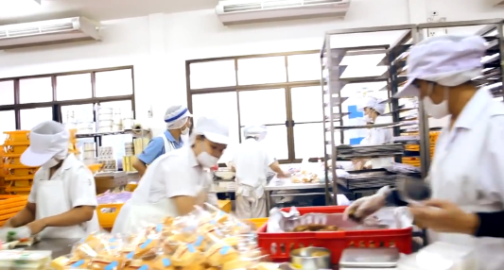
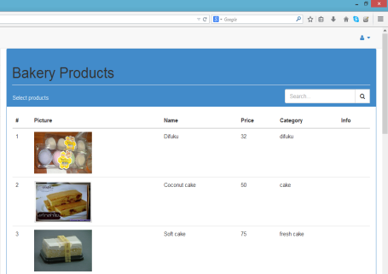


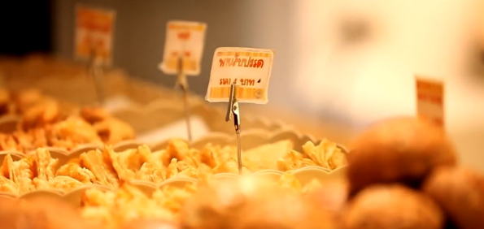
Estimating
ingredient usage
Introduction
Web-application
Ordering
a fresh bakery product
C#
ASP.NET

Slide 4
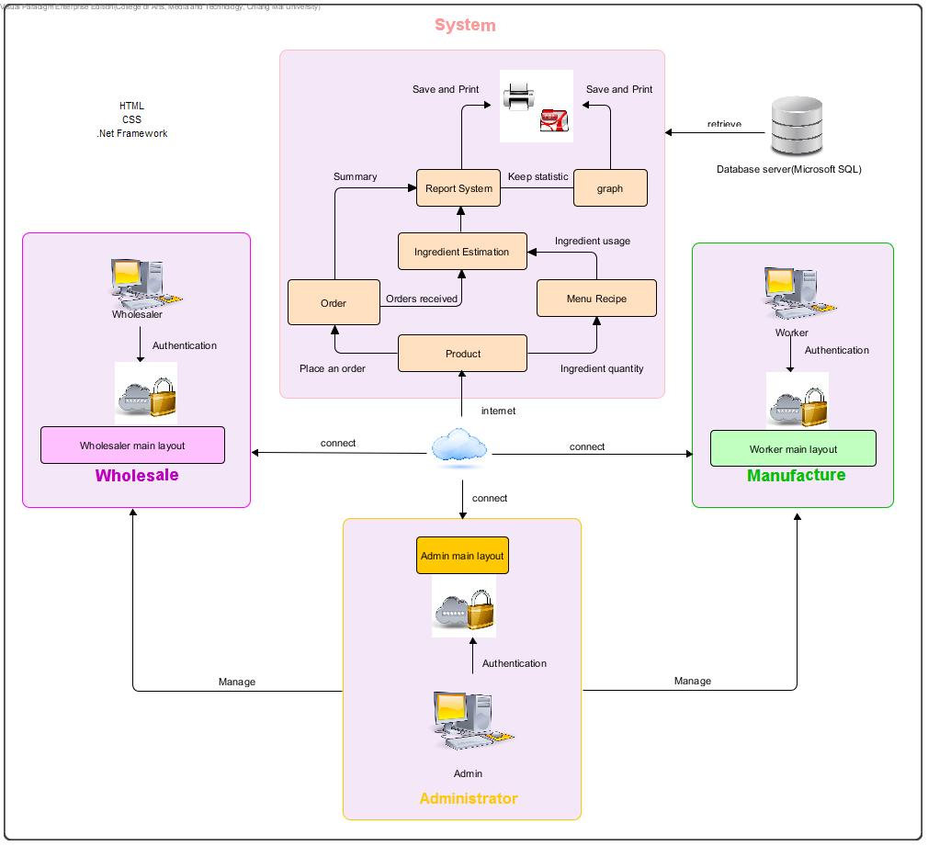
“ System Architecture ”

Slide 5

P
Project name: Web-based Ordering & Ingredient Estimating for Bakery Manufacturer
Prepared by: Nontra Nonsee Parinya Panyanak | Date: 1 July 2015 |  | Report Process: Project Final Progress Report
Project Overall Status: 100 %
Feature 1: User management system Feature 2: Product system Feature 3: Order system Feature 4: Ingredient management system Feature 5: Ingredient Estimation Feature 6: Report System
Milestone Deliverables performance reporting
Milestone Deliverables |  | Due Date | % Complete | Deliverable Status
Project Final Progress Report
Software Project Management Plan |  | 1 July 2015 | 100 % | On schedule
Software Requirement Specification |  | 1 July 2015 | 100 % | On schedule
Software Design Document |  | 1 July 2015 | 100 % | On schedule
Software Implementation |  | 1 July 2015 | 100 % | On schedule
Test Plan |  | 1 July 2015 | 100 % | On schedule
Test Record |  | 1 July 2015 | 100 % | On schedule
Traceability Record |  | 1 July 2015 | 100 % | On schedule
R
O
J
E
C
S T ATUS

Slide 6
No. | Review Item | Responsibility | Reviewer
1 | Project Management Plan | NN | All members Advisor
2 | Project Proposal | All members | All members Advisor
 | Software Requirement Specification | NN | All members Advisor
3 | Software Design Document | PP | All members Advisor
4 | Implementation | PP | All members Advisor
 | Unit Test Report | PP | All members Advisor
5 | System Test Report | PP | All members Advisor
6 | Traceability Record | NN | All members Advisor
 | Project Status Report | NN | All members Advisor
 | Change Request | NN | All members Advisor
W
ork List

Slide 7
P
roject Management Plan
Estimate Duration
Development Model
Change Management
Configuration Item Table
Repository Tool

Slide 8




Proposal
Start: 26 January 2015
End: 16 June 2015
Progress Report I
Start: 18 February 2015
End: 17 March 2015
Estimate Duration
Progress Report II
Start: 18 March 2015
End: 30 April 2015
Final Progress
Start: 02 May 2015
End: 01 July 2015

Slide 9
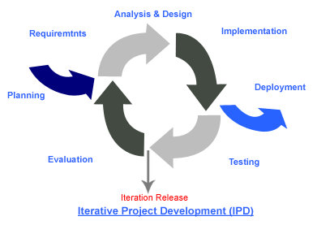
Development Model
Create a high-level design of the application before begin to build the product

Slide 10



Specify version of a document
Change Management
Approving by project advisor
Creating a requirement traceability

Slide 11
No. | Item name | File name | File Type | Owner (Role) | Repository (Path) | Baseline Version
1 | Project Proposal | Web-based Ordering & Ingredient Estimating for Bakery Manufacturer – Project Proposal_V.1.4 | .docx | PP, NN | D:\Senior Project\Project Proposal\Docx\PP | 1.4
2 | Project Management Plan | Web-based Ordering & Ingredient Estimating for Bakery Manufacturer – PMP_V.3.0 | .docx | PP, NN | D:\Senior Project\Project Final\Docx\PMP | 3.0
3 | Software Requirement Specification | Web-based Ordering & Ingredient Estimating for Bakery Manufacturer – SRS_V.3.0 | . docx | PP, NN | D:\Senior Project\Project Final\Docx\SRS | 3.0
4 | Software Design Document | Web-based Ordering & Ingredient Estimating for Bakery Manufacturer – SDD_V.3.0 | .docx | PP, NN | D:\Senior Project\Project Final\Docx\SDD | 3.0
5 | Test Plan | Web-based Ordering & Ingredient Estimating for Bakery Manufacturer – Test Plan_V.3.0 | .docx | PP, NN | D:\Senior Project\Project Final\Docx\TP | 3.0
6 | Traceability Record | Web-based Ordering & Ingredient Estimating for Bakery Manufacturer – TR_V.3.0 | .docx | PP, NN | D:\Senior Project\Project Final\Docx\TR | 3.0
Configuration Item Table

Slide 12
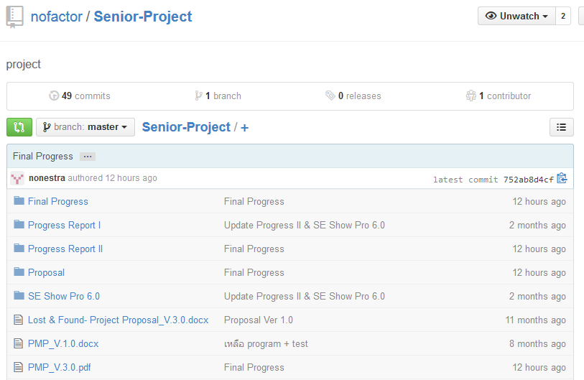

Repository Tool

Slide 13
R
equirement Specification
Analyze Requirement
24 User Requirement Specification
152 System Requirement Specification
35 Activity Diagram

Slide 14

User Requirement Specification
URS-05: Member can view own personal information
SRS-01: The system can connect to the phungnoi database and access Member and webpages_Roles tables.
SRS-26: The system shall provide a link for viewing member information in the member profile interface.
SRS-27: The system shall provide a user interface to display the existing member information which are the member ID, username, password, first name, last name, phone number, address, role name, create date, last sign in date, and profile picture on member profile page.

Slide 15
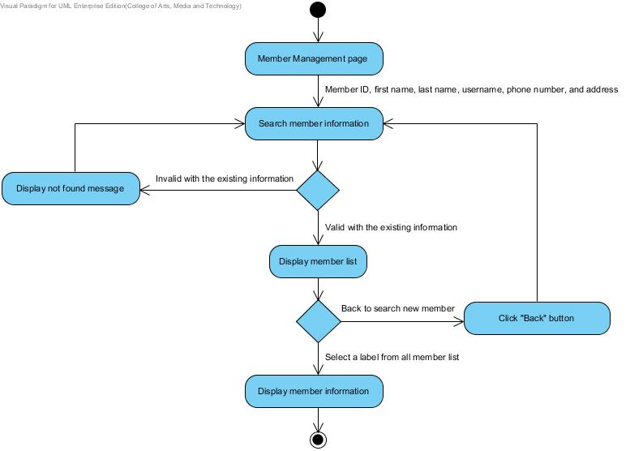
Activity Diagram
AD – 08
Admin view all member information

Slide 16
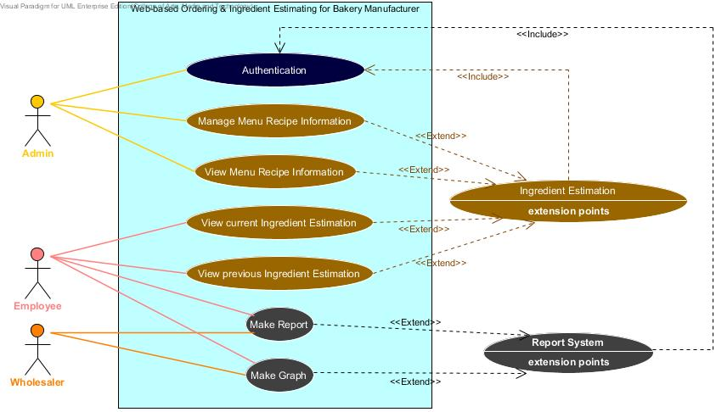

Use Case Scenarios

Slide 17
D
esign Document
Class Diagram
28 Sequence Diagram
32 User Interface
Database Design
Notes:
มีรายละเอียดดังนี้

Slide 18
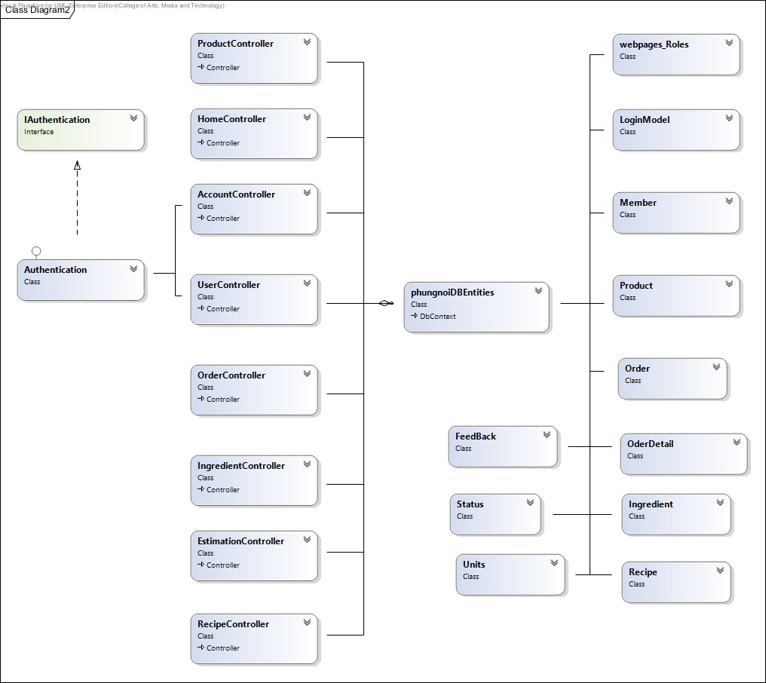

Class Diagram

Slide 19
Sequence Diagram
SD – 20: Admin create menu recipe information

Slide 20
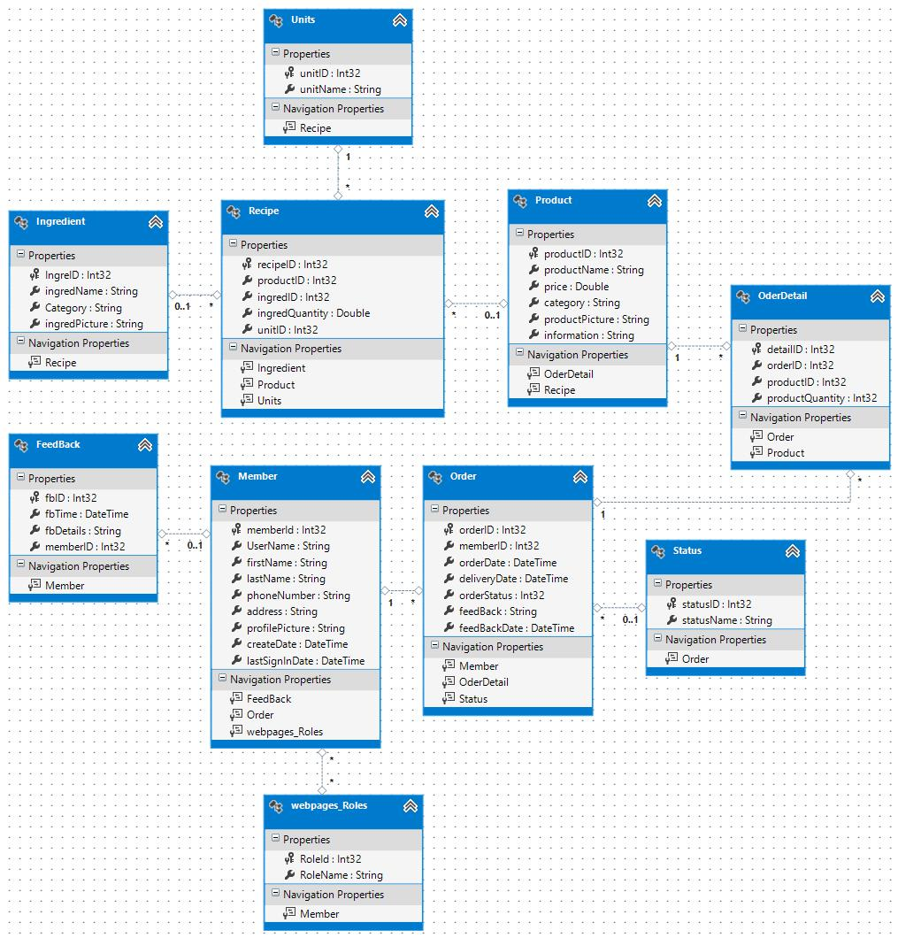

Database Design

Slide 21
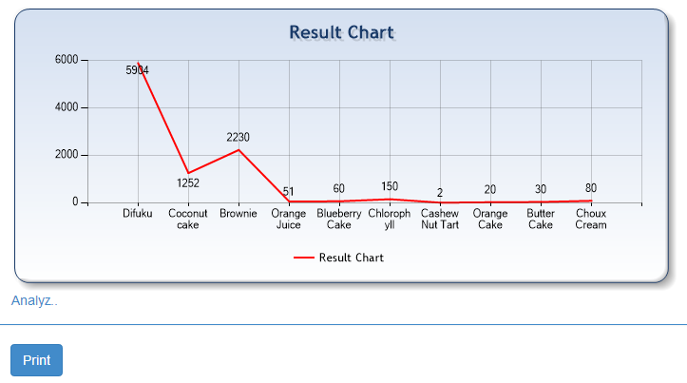
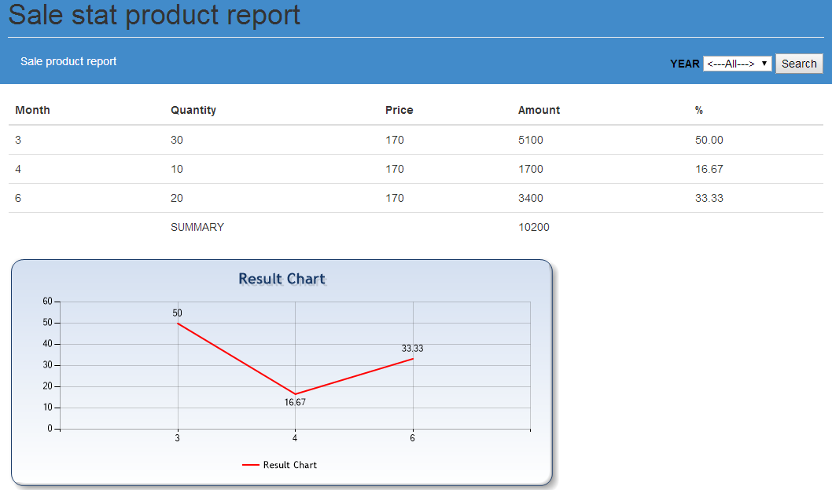
UI – 29: Estimation Chart
User Interface
UI – 30: Statistical Chart

Slide 22
I
mplementation
User
Ingredient Estimation
Order
Product
Ingredient
Report

Slide 23


Development
Software Requirement Specification (SRS)
Software Design Document
(SDD)

Slide 24
T
esting Document
Test Plan
Test Record
Notes:
มีรายละเอียดดังนี้

Slide 25

Unit Test Case-02(UTC-02)
public ActionResultLogin (LoginModel model, string returnUrl)
This unit test case used to check procedure of Login () method that can work correctly.
Unit Testing
No. | Description | Input | Expected output
1 | Login with valid username and password | { Username == “tung@dd.com”, Password == “123456”, RememberMe == false}, {returnUrl == null} | RedirectToLocal (null);
2 | Login with invalid username and password | { Username == “tung@dd.com”, Password == “555555”, RememberMe == false}, {returnUrl == null} | return View ("Login", "_PlainLayout", { Username == “tung@dd.com”, Password == “555555”, RememberMe == false});

Slide 26

No. | Expected output | Actual output | Pass/Fail
1 | RedirectToLocal (null); | RedirectToLocal (null); | Pass
2 | return View ("Login", "_PlainLayout", { Username == “tung@dd.com”, Password == “555555”, RememberMe == false}); | return View ("Login", "_PlainLayout", { Username == “tung@dd.com”, Password == “555555”, RememberMe == false}); | Pass
Unit
Test Record

Slide 27


System Test Case-10(STC-10)
Admin can manage all bakery product information by edit product.
No. | Description | Input | Expected output
1 | Test with input all correctly information to the product form and bakery product information can update into the database. | Product Name: “Brownie” Information: A chocolate brownie is a flat or baked square. Price: 29.00 Category: “Bread” | Update bakery product information success and keep updated information in the database. After that the system will redirect to the product page.
2 | Test with invalid input information type to the product form. | Price: goods | Display error message “Please input with a number.” After that the system gives an admin input new information again.
SystemTesting

Slide 28
No. | Expected Result | Actual Result | Pass/Fail
1 | Update bakery product information success and keep updated information in the database. After that the system will redirect to the product page. | Update bakery product information success and keep updated information in the database. After that the system will redirect to the product page. | Pass
2 | Display error message “Please input with a number.” After that the system gives an admin input new information again. | Display error message “Please input with a number.” After that the system gives an admin input new information again. | Pass
System
Test Record

Slide 29
T
raceability Record
Traceability Record Table

Slide 30
Traceability Record Table
URS-12: Worker view current order information.
System Requirement Specification
SRS-31, SRS-75, SRS-76, SRS-77, SRS-78, SRS-79 ,SRS-80
User Interface
UI-04, UI-23, UI-25
Sequence Diagram
SD-14
Activity Diagram
AD-20
Use Case
UC-10
Unit Test Case
UTC-12, UTC-13
System Test Case
STC-17
Database
DB-01, DB-02, DB-07, DB-09

Slide 31
D
emo

Slide 32

P
roblems
Lack writing english skills.
Bad communication between team members.
Requirements might be changed.
Unit test case not enough.
Have a problem with sequence diagram
Deliverables delay.

Slide 33
THANK YOU

Slide 34

“ Question and Answer ”
Where ?
Why ?
What ?
When ?
Who ?

